Slide 1
P.A.R.C.E.L.
Payload Autonomous Robot for Coordination, Expedition, and Logistics
Group 24
Riley Newport, CpE
Melyia Ince-Ingram, CpE
Brandon Zabawa, CpE
Ibrahim Khater, EE

Slide 2

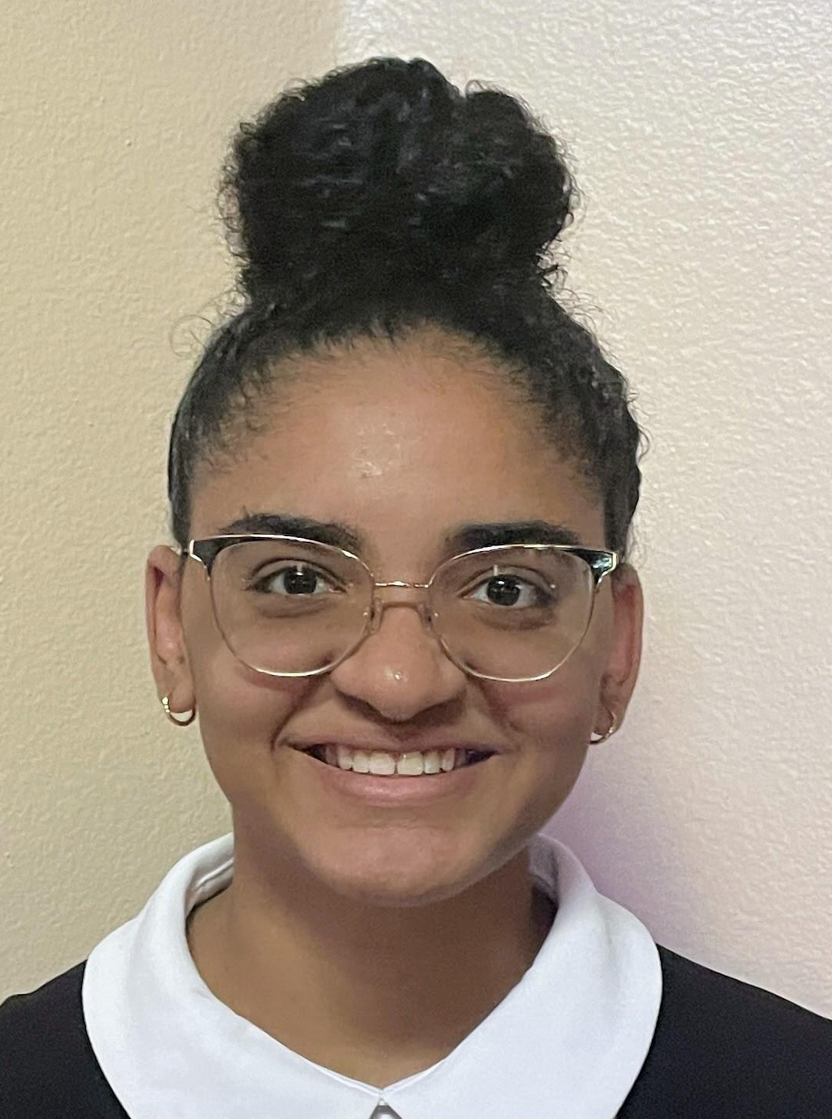


Meet the Team
Riley Newport
Melyia Ince-Ingram
Brandon Zabawa
Ibrahim Khater
Computer Engineering
Computer Engineering
Computer Engineering
Electrical Engineering

Slide 3
Motivation and Background
Advanced robotics and other complex technologies are quickly becoming essential in making factories more efficient and flexible.
Autonomous robots now play key roles in logistics, healthcare and more boosting efficiency, reliability, and cost savings.
This project aims to bridge these gaps, providing a flexible, cost-effective, and efficient system tailored for factory use.
The project integrates hardware and software to enable autonomy using
  Radio Frequency Identification (RFID) systems for object identification
  A two wheel differential drive system
  2D SLAM for path planning and navigation with LiDAR
  App integration for monitoring

Slide 4

Goals and Objectives
Goals:
safely transport payloads from one location to another and return to its home location
avoiding obstacles
to detect if a payload is on top of it and identify the payload correctly
create a new path to the target location if the original path is blocked
mobile application for the user to view the robot’s status
Objectives
Payload detection: Photoresistor to confirm when items are loaded or removed.
Payload identification: Short-range HF RFID sensor to track and differentiate payloads.
Obstacle avoidance: Distance sensor array to detect objects and reroute paths.
Navigation: API/mapping toolbox on Raspberry Pi for autonomous path planning.
User interaction: Mobile app for delivery location monitoring.

Slide 5
Engineering Specifications
Parameter | Specification
System Specifications
Arrival Distance from Destination | < 1m of its destination
Object Avoidance | Detects objects < 1m
Payload Identification Accuracy | > 90%

Slide 6
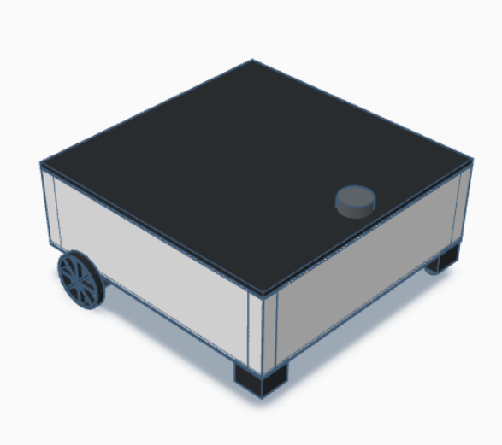
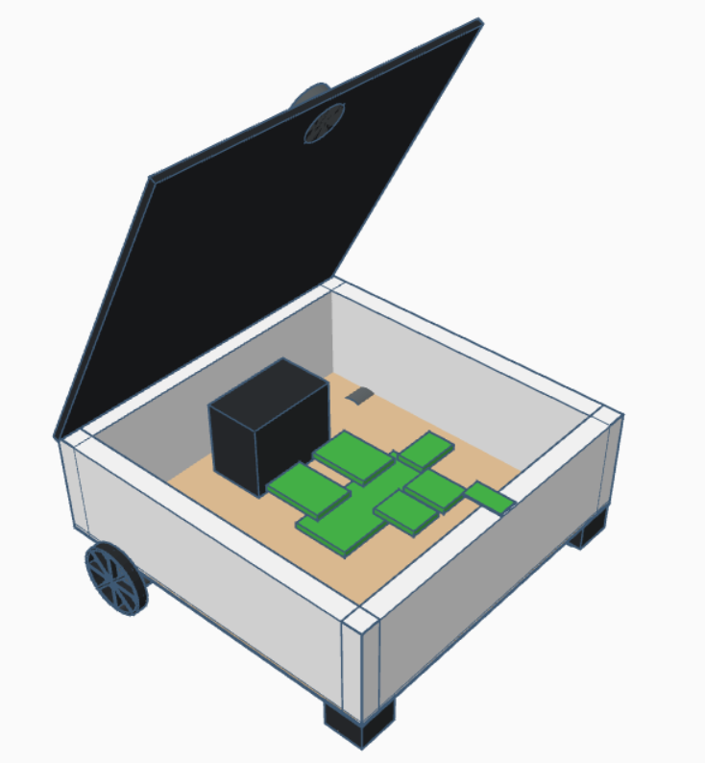
Robot Overview
Overall Mechanical Design Details
2 Motor Wheels in the back
2 Caster Balls in the front
Hinge Top for Easy Access to Electronics
L x W x H = 20x18x8 in

Slide 7
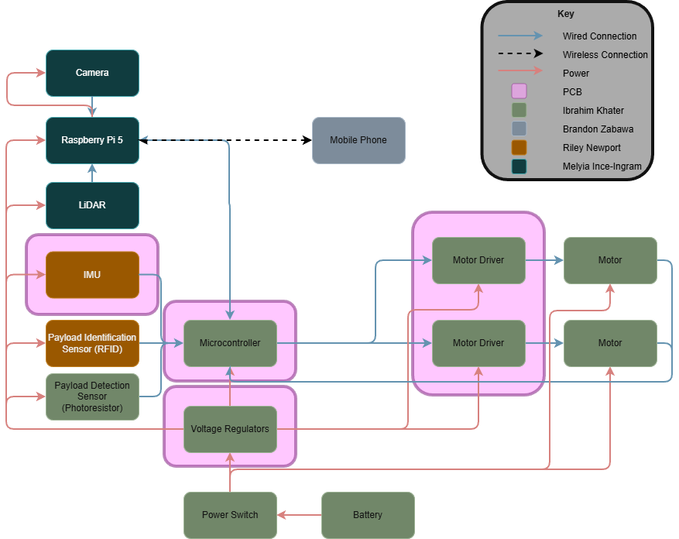
Hardware Design - Overall Block Diagram

Slide 8
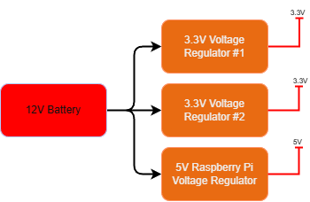
Hardware Design - Power Block Diagram

Slide 9
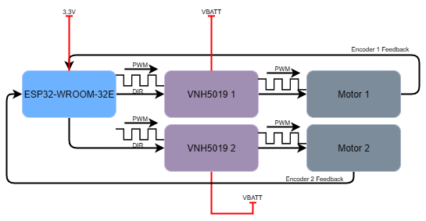
Hardware Design - Motor Controller Block Diagram

Slide 10
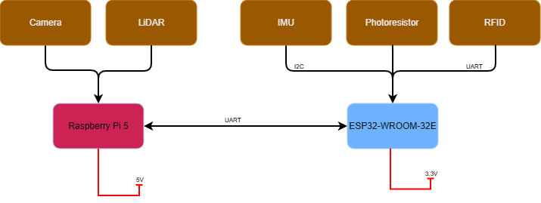
Hardware Design - Sensors Block Diagram

Slide 11
Hardware Design - PCBs
Mainboard
  ESP32 MCU
  IMU
  GPIO Expander
  Connectors for peripherals and external sensors
Power
  3V3 Regulator Board
  5V Regulator Board
  5V2 Raspberry Pi Regulator Board
Motor Controller
  Control speed and direction of motors

Slide 12
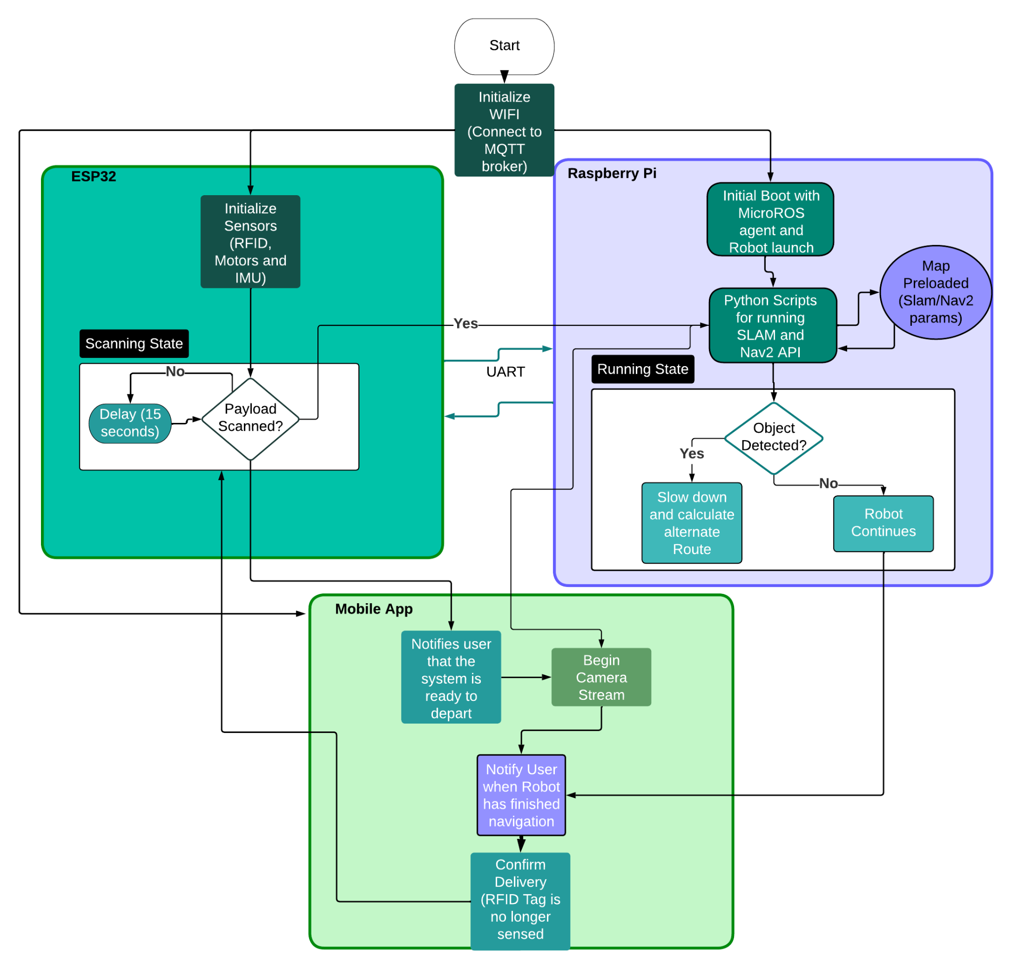
Software Design - Software Flowchart

Slide 13
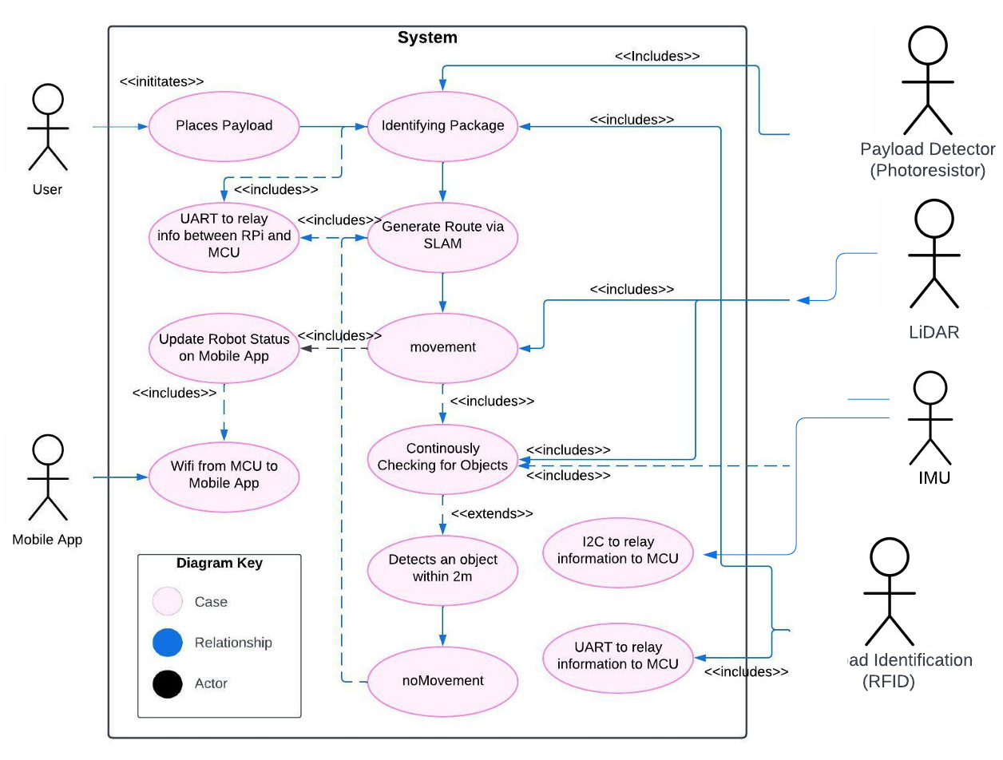
Software Design - Use Case

Slide 14
Comparison and Selection of Hardware -
Payload Identification
Barcodes/QR Codes vs. RFID
Barcodes/QR Codes | RFID
Direct line of sight | Without direct line of sight and through objects
Closer proximity | Farther proximity
Data is read only | Data is read and write
Only identify the type of item | Can uniquely identify each item tagged
Read only one at at time | Read multiple tags simultaneously
Read time > 500ms per tag | Read time is < 100ms per tag
More subject to wear on payload | Less subject to wear on payload
Less costly than RFID | More costly than Barcodes/QR Codes
Final Reasoning for RFID:
That data is read and write so payload info can be updated
It allows for items to be uniquely identified instead of only the type of items

Slide 15
Comparison and Selection of Hardware -
Payload Identification
Types of RFID Tags
Passive | Semi Passive | Active
Components: Integrated Circuit, Antenna | Components: Integrated Circuit, Antenna, Battery | Components: integrated circuit, antenna, battery, on-board transmitter
Receives power from the reader through inductive coupling | Powers its circuitry and processing capabilities, still relying on the reader to activate and transmit data | transmitter sends energy directly to the reader
Shortest range | Medium range | Longest range
Small size | Small size | Larger size
Typically least expensive | Medium price | Most expensive
Longest lifespan | Medium lifespan | Shortest lifespan
Final Reasoning for Passive RFID Tags:
lowest cost
longest lifespan

Slide 16
Comparison and Selection of Hardware -
Payload Identification
Frequency of Passive Tags
Low Frequency | High Frequency | Ultra High Frequency
Available in 125kHz, 134kHz | Available in 13.56 MHz | Available in 860–960 MHz
near-field inductive coupling | near-field inductive coupling | far-field radiative coupling also known as backscatter coupling
read range of a few inches | Read range less than 3 feet | Read range of 15 to 20 feet
lowest data transfer rate | Medium data transfer rate | Highest data transfer rate
No anti-collision → can’t read multiple simultaneously | Some have anti-collision, most do not have anti-collision | All have anti-collision → allowing multiple tags to be read simultaneously
expensive to manufacture | lower in cost than LF tags due to simpler antenna design | UHF readers are more expensive than HF readers
Final Reasoning for High Frequency Tags:
More reliable and less complex than UHF
LF is most expensive

Slide 17
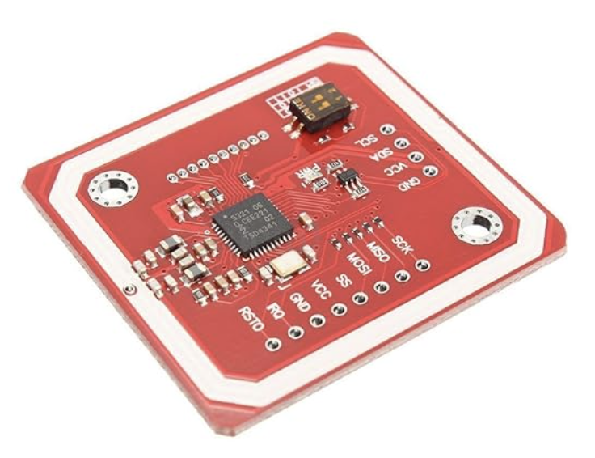
Comparison and Selection of Hardware -
Payload Identification
High Frequency RFID Reader Modules
RYRR10S [C.5] | RYRR20I_DE [C.6] | RC522 [C.40] | PN532
Read Only | Read Only | Read/Write | Read/Write
Tags: ISO15693, ISO14443A, ISO14443B | Tags: ISO14443A ISO14443B, , ISO15693, FeliCa, ISO18092 | Tags: ISO/IEC 14443 A/MIFARE and NTAG | Tags: Mifare 1k, 4k, Ultralight, and DesFire cards, ISO/IEC 14443-4
Range: 4cm to 8cm | Range: 4cm | Range: a few cms | Range: a few cms
Communication Protocols: UART, SPI | Communication Protocols: UART | Communication: SPI, UART, I2C | Communication: I2C, SPI and HSU (High Speed UART)
$6.00 | $15.00 | $6.99 | $8.99
Final Reasoning for PN532:
Easy to use library available to communicate with the ESP32

Slide 18
Comparison and Selection of Hardware -
Distance Sensor
Ultrasonic vs. Optical TOF vs. LiDAR
Ultrasonic | Optical TOF | LiDAR
Less accurate with objects that absorb sound waves | Independent of object material | Independent of object material
Independent of target colors and reflectivity | Possibly can be affected by target colors and reflectivity | Better performance than optical TOF but can still be affected by target colors and reflectivity
Ambient immune | Ambient interference | Ambient interference, FMCW is ambient immune
few cm to several meters | few mm to several meters | several meters to hundreds of meters
Slower response time | Fast response time | Fastest response time
Moderate accuracy | High accuracy | Highest accuracy
Low power consumption | Low power consumption | Usually higher power consumption than Ultrasonic and TOF
Least expensive | More expensive by a little | Most expensive and by a large margin
Final Reasoning for LiDAR:
Highest accuracy
Integrates with NAV2
Already had one available

Slide 19
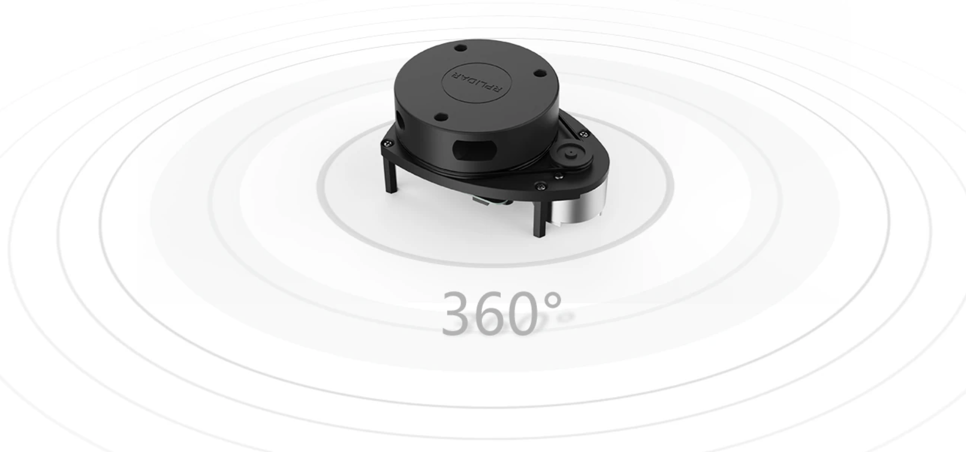
Comparison and Selection of Hardware -
Distance Sensor
LiDAR Models
RP LIDAR A1 | SLAMTEC RPLIDAR C1 360° DTOF Laser Scanner
Range: 12m 360 degree Range Omnidirectional | Range: 12m 360 degree Range Omnidirectional
Operating Voltage: 5V | Operating Voltage: 5V
Frequency : Configurable Scan Rate from 2-10Hz | Frequency: 8 -12 Hz
Communication: micro-USB into Raspberry Pi | TTL UART
Cost: borrowed/no cost to us | Cost: $90.45
Final Reasoning for RP LiDAR A1:
Designed to be ideal for robot navigation and localization
Already acquired for free

Slide 20
Comparison and Selection of Hardware
- Single Board Computer
Single Board Computers
Specifications | Raspberry Pi 5 | Raspberry Pi 4B | Nvidia Jetson Nano | Arduino Mega
CPU | 2.4GHz quad-core 64-bit Arm Cortex-A76 CPU | Quad-core Cortex-A72 at 1.5GHz | ARM Cortex -A57 MPCore (Quad-Core) | Quad-core ARM Cortex-A57 at 1.43GHz
RAM | 8GB LPDDR4X SDRAM | 8GB LPDDR4 | 4GB at 1600MHz LPDDR4 | 8KB SRAM
Wireless Connectivity | Dual-band 802.11ac Wi-Fi,Bluetooth 5.0 / Bluetooth Low Energy (BLE) | 2.4- 5.0 GHz IEEE 802.11b/g/n/ac wireless LAN, Bluetooth 5.0 | No WiFi | No WiFi/Bluetooth
Input Power | 5V/5A DC power via USB-Ct | 5V/3A DC via USB-C connector and GPIO | 5.0V DC input | 5V/200mA DC Input
GPIO | Standard 40-pin header | Standard 40-pin GPIO header | Standard 40-pin GPIO header | 54 digital I/O pins
Communication | Same as Raspberry Pi 4 | 1 bus I2C,SPI, 1 UART | 4 ports UART,SPI,I2C | GPIO UART,SPI, I2C
GPU | VideoCore VII GPU | VideoCore VI | 128-core GPU | None
Software Support | Linux, ROS2 | Linux, ROS2 | Linux, AI-based CUDA acceleration | Arduino
Final Reasoning for Raspberry Pi 5
Readily available
Handles the computational load of SLAM and Nav2

Slide 21
Comparison and Selection of Hardware - Inertial Measurement Unit
Feature | 6-Axis IMU | 9-Axis IMU
Sensors | 3-axis gyroscope, 3-axis accelerometer | 3-axis gyroscope, 3-axis accelerometer, 3-axis magnetometer
Complexity | Low | Moderate
Susceptibility to Interference | Low | High
Power Consumption | Low | Moderate
Cost | Low | Moderate
Feature | MPU-6050 | ICM-42688 | LSM6DSO
Comm. Interface | I2C | I2C/I3C/SPI | I2C/I3C/SPI
Power Consumption | Moderate | Moderate | Low
Noise | Moderate | Low | Low
Accelerometer Range (g) | ±2 to ±16 | ±2 to ±16 | ±2 to ±16
Gyroscope Range (dps) | ±250 to ±2000 | ±15.625 to ±2000 | ±125 to ±2000
Cost | Very Low | Low | Low
Final Reasoning for MPU6050:
Low cost, consistent, and easy to integrate
Notes:
An IMU will be used to provide motion tracking data. IMUs can be classified by the number of axes: 3, 6, or 9.
3 immediately eliminated as it fails to provide enough data for tracking. 6 and 9 axis are then compared. While a 9 axis could provide the robot with more heading info and more accurate movement, the robot primarily relies on the algorithm and various sensors for localization. Introducing a magnetometer comes with more complexities and is more susceptible to noise. thus the magnetometer on a 9 axis IMU is unnecessary.
Comparing different 6 axis IMUs, we decided that the IIM-20670 is the best option. With a low power consumption and easily solderable IC package, the IIM is easy to integrate and work with on our system.

Slide 22
Comparison and Selection of Hardware - Microcontroller
Final Reasoning for ESP32
High processing speed, built-in wireless communication, strong peripheral support, and an extensive community
Microcontroller | Processing Speed | Power Consumption | Communication Interfaces | Cost
ESP32-WROOM-32E | 240 MHz | Medium (3-3.6 V, 0.5 A) | UART, SPI, I2C, Wi-Fi, Bluetooth | Low
STM32F103C8T6 | 72 MHz | Low (2-3.6 V, ~50mA) | I2C, USART, SPI, CAN, USB | Moderate
ATmega328p | 16 MHz | Low (2.7-5.5 V, ~20mA) | USART, SPI, I2C | Low
PIC18F45K22 | 64 MHz | Very low (2.7-5.5 V, ~10mA) | EUSART, SPI, I2C | Low
Notes:
The MCU is a crucial part of the system. It will serve as core unit for handling all of the control tasks and take in most of the sensor data in real time. It needs to support multiple different communication protocols to interface with all the sensors and the raspberry pi. Processing power is another major factor as the MCU should be able to handle a variety of sensor inputs as well as motor control without significant delays.
The functionalities of the MCU are also crucial. For example, in order to properly control the motors the MCU must be able to produce a stable PWM signal. The selected MCU must have all of this as well as abundant GPIO pins available and be cost effective. With all of this in mind, the ESP32 series emerges as the most suitable option for this project. It’s a low cost MCU that meets all of the minimum criteria and has built-in WiFi and Bluetooth capabilities.

Slide 23
Comparison and Selection of Hardware - I/O Expander
Final Reasoning for TCA9554PWR
Simple to use and integrate for GPIO expansion
Specification | TCA9554PWR | MCP23S17 | PCA9555
Interface | I2C/SMBus | SPI | I2C/SMBus
Voltage (V) | 1.65-5.5 | 1.8-5.5 | 2.3-5.5
I/O Count | 8 | 16 | 16
Interrupt | Yes | Yes | Yes
Notes:
In order to ensure that there are enough GPIOs for the peripherals, an IO expander is needed. The IO expander will be minimal and handle a number of extra components to ensure full functionality of the system. The expander will need to support I2C communication as SPI is already being used by the IMU. for this project, the TCA9554 was selected as it is more compact and fulfills the minimum requirements for the while providing enough additional IOs.

Slide 24
Comparison and Selection of Hardware - Motor Type
Final Reasoning for Brushed DC Motor
High torque and simple to control at a low cost
Motor Type | Torque | Power Consumption | Control Precision | Control Complexity | Cost
Brushed DC Motor | High | High | Medium | Low | Low
Brushless DC Motor | High | Low | High | High | High
Stepper Motor | High | High | High | Moderate | Low
Servo Motor | High | Moderate | High | Moderate | Moderate-High
Notes:
The robot will be driven with two motors. They need to provide the necessary torque and speed to move the robot while also ensuring simplicity and precise control. The mcu must be able to fine tune the motors and ensure the robot is moving at a constant speed and as desired. Power consumption and cost are also very important criteria to consider. After evaluating different types of motors, brushed DC motors were selected due to their ideal balance: theyre simple to use, cost effective, and easy to control through PWM.

Slide 25
Comparison and Selection of Hardware - Motor
Motor | Voltage (V) | Current (A) | Torque (Nm) | Speed (RPM) | Weight (g) | Control Feedback | Cost ($)
Pololu 2828 | 12 | 0.2-5.5 | 0.5-5 | 67 | 210 | Encoder | 51.95
24PG-2430BL-1260-256 | 12 | 0.5-1.9 | 1-3 | 18.5-23 | NA | None | 19.69
CQRobot 70:1 Metal DC Geared-Down Motor | 12 | 0.2-5.5 | 2.65 | 150 | NA | Encoder | 33.99
638266 | 12 | 0.54-1.2 | 2-4 | 20-26 | 380 | None | 39.99
Final Reasoning for CQRobot 70:1:
Strong torque output, built-in encoder feedback, and low cost
Notes:
After determining that a brushed DC motor would be used, different specific models were compared. Analyzing the criteria and features of each motor led us to the decision of using the Pololu 2828. While its a bit on the higher end in terms of cost, it provides sufficient torque and speed. It comes integrated with an encoder that will allow us to more accurately control the motors individually through the MCU.

Slide 26
Comparison and Selection of Hardware - Motor Driver
Specification | TB9051FTG | VNH5019 | DRV8871 | MC33926
Input Voltage (V) | 4.5-28 | 5.5-24 | 6.5-45 | 5-28
Output Current (A) | 5 | 30 | 4 | 5
Protection Features | Overcurrent, Overvoltage, Thermal Shutdown | Overcurrent, Overvoltage, Thermal Shutdown | Thermal Shutdown | Overcurrent, Thermal Shutdown
Control Interface | PWM + DIR | PWM + DIR | PWM | PWM + DIR
Price | Moderate | Moderate | Low | Moderate
Final Reasoning for VNH5019:
Very high current capability, wide voltage range, and built-in protection features
Notes:
An H bridge motor driver is needed to control the motor’s speed and direction. The robot must be able to go forwards and backwards as well as change speeds easily. Our motors have a maximum current draw of 5A so the driver’s output must be higher than that. Therefore, the best option is the VNH5019. It provides both speed and directional control via PWM and digital IOs respectively and boasts a maximum output current of 30A, well over our needed maximum. It also provides built-in overcurrent, overvoltage, and thermal shutdown protection.

Slide 27
Comparison and Selection of Hardware - Power Supply
Feature | Lithium-Ion | LiPo | NiCd | NiMH | Lead Acid
Specific Energy (Wh/kg) | 150-200 | 140-200 | 40-60 | 60-120 | 30-40
Self-Discharge Rate (%/month) | 5-10 | 5-10 | 20 | 30 | 3-20
Memory Effect | No | No | Yes | Yes | No
Weight | Light | Very Light | Heavy | Medium | Heavy
Cost | $75+ | $150+ | $100+ | $150+ | $20-30
Advantages | High energy density, low self-discharge, no memory effect | High energy density, low self-discharge, no memory effect, small and thin | Long life cycle | Inexpensive | High surge currents, very low cost, easy to use, low self-discharge
Disadvantages | Expensive, can overheat, safety concerns | Expensive, can overheat, safety concerns | Requires frequent discharging, heavy | Low capacity, high self- discharge, toxic materials | Low energy-to- weight ratio, corrosion, heavy
Final Reasoning for Lead Acid:
Low cost, high surge current capability, and simple, reliable operation
Notes:
The robot and all peripherals must be sufficiently powered while also maintaining portability. For this reason, different types of batteries were compared. Taking into account the motors and the rest of the system, a 12V battery would be ideal. The different battery types considered are lithium ion, lipo, nicd, nimh, and lead acid. Each type offers distinct advantages and disadvantages. Lithium ion and lipo batteries provide high energy density and are lightweight, but come with high costs, safety risks, and are more complex to integrate. NiCd and NiMH, while offering good durability, have a lower energy density and suffer from memory effect, leading to lower capacity over time. Lead acid batteries, despite being heavier than the other options, emerge as the most suitable choice due to their combination of safety, reliability, cost effectiveness, and ease of maintenance. Considering all of this, lead acid batteries were selected for this project.

Slide 28
Comparison and Selection of Hardware - Voltage Regulators
Component | Operating Voltage (V) | Max Current (A) | Max Power (W)
ESP32 | 3.3 | 0.5 | 1.65
Raspberry Pi 5 | 5.0 | 5.0 | 25.0
VNH5019 (x2) | 3.3 | 0.016 | 0.0528
DC Motors (x2) | 12 | 11 | 132
RFID Module | 3.3 | 0.12 | 0.396
IMU | 3.3 | 0.01 | 0.033
Total |  | 16.646 | 159.1318
3.3V Buck Regulator (LM2576-3.3) | 5.2V Buck Regulator (LM2679SX-ADJ)
ESP32 Motor Drivers RFID IMU GPIO Expander | Raspberry Pi 5
Notes:
Based on the power requirements of all the components in the system, Two different voltage regulator circuits will be used.
A fixed LM2576 at 3.3V that will handle the bulk of the power distribution, going to the ESP, motor drivers, RFID module, IMU, the GPIO expander, and the motor encoders
An adjustable LM2679 set to 5.2V is reserved specifically for the raspberry pi. We’re using an adjustable version rather than a fixed to account for the voltage drop and ensure the raspberry pi is getting sufficient voltage to operate.

Slide 29
Comparison and Selection of Software
- SLAM Protocols
Features | Visual SLAM | LiDAR SLAM
Technology Used | Visual sensors (Monocular, Stereo, RGB-D cameras) | LiDAR sensors (Laser based sensors)
Cost | Moderate | Moderate
Power Consumption | Low (Cameras use less power) | High
Computational Load | High (including feature and frame processing) | Medium (point cloud processing)
Mapping Accuracy | Good but affected by lighting | High
Obstacle Detection | Moderate | High
Environment Conditions | Affected by lighting and visual obstructions | Not affected by conditions
Final Reasoning:
More accurate in terms of not being affected by indoor lighting conditions
Easier to interface with SLAM

Slide 30
Comparison and Selection of Software
- SLAM
Feature | SLAM Toolbox | Cartographer
Algorithm | 2D Pose Graph SLAM | Graph-Based SLAM but with a submap
Sensors Required | Works with Laser Scans and wheel odometry out of box | Can work with just a lidar scan and use sensor fusion
Mapping Type | 2D with lifelong mapping | 2D and 3D
Loop Closure Method | Supports loop closure; pose graph, lifelong mapping modes | Very strong loop closure & optimization
Real-Time Capability | Ideal for real-time tracking feature extraction | Excellent Real-time tracking but with high hardware demand
Computational Load | Moderate efficiency | Highly Intensive
Use Cases | Indoor/outdoor navigation, object tracking and localization | Large-scale mapping, multi-session SLAM, long-term environment tracking
Cost | Open sourced | Open Sourced
Final Reasoning:
Widely supported documentation and resources
Ease of Use

Slide 31
Comparison and Selection of Software - Path Planning
Path Planning Algorithms (Nav2 slam_toolbox)
Feature | Navfn | DWA
Algorithm Type | A* algorithm | Velocity-space sampling
Use Cases | Navigates large, known environments | Indoor real-time reactive obstacle avoidance
Input | Start & goal pose from SLAM | Current robot pose via SLAM, velocity, local costmap
Planning Type | Global Path Planning | Local Path Planning
Obstacle Avoidance | Avoids known static obstacles in global map | Dynamic obstacle avoidance
Computational Load | Efficient but Slightly higher load | CPU-Accelerated/ Lightweight
Real-Time Function | Runs occasionally, not frequent | Continuously running and scanning
Limitations | Doesn’t account for robot dynamics; static environments | Needs a costmap; poor in congested areas
ROS | Integrated with the nav2 package | Integrated with ROS2’s nav2 package
Ease of Use | Simple setup with Nav2 controller | Works as a package in the Nav2 plugin in ROS2
Final Reasoning:
Not as computationally heavy as other path planning algorithms
Implements obstacle avoidance effectively

Slide 32
Comparison and Selection of Software - Mobile App (Frontend)
Feature | Flutter | Python
Platform Capability | IOS/Android | iOS/Android
Programming Language | Dart | Flask
UI Implementation | Numerous multi-useful widgets | Flexible Micro-web framework to create websites on all platforms.
Robot Integration | More tools to solve issues | Focus is on creating APIs/Sockets for network communications that can work with ROS by acting as the Middleman
User Complexity | Moderate-High | Low-Moderate (depends on level of experience)
Efficiency | Variable (depends on API/Optimizations) | Variable (Flasks pros become cons as applications complexity grows).
Final Reasoning:
Greater tools meant better ways overcoming challenges such as Network issues.
Steep initial learning curve due to syntax, but tolerable to manage overtime.
Notes:
Flutter vs. Python (Frontend)
For our project, Flutter ended up as the main frontend framework, while Python and C++ were used primarily on the backend.
The trade-off is a steeper learning curve. To build the app, we had to learn Dart, which is the programming language, and Flutter, which is the UI framework and widget library built on top of Dart.
Like Python, Flutter and Dart have extensive official documentation and community resources, so we could usually look up how to implement specific features, just as we would with Python’s docs.
In our app, the livestream and livemap each needed slightly different frontend logic to pull images or data over the network and render them on screen. Flutter’s networking support (via packages like http) and its image widgets made it possible to fetch data from HTTP endpoints and display it in the UI.
In the final decision, Python and C++ run on the devices as backend services, handling data processing and exposing HTTP endpoints. Flutter acts as the client: it sends standard HTTP requests such as GET and POST to those endpoints, then uses its UI widgets to present the livestream, livemap, and telemetry coming from the ESP32 and Raspberry Pi 5 to the user.

Slide 33
Image of Speaker
Comparison and Selection of Communication Protocols
WiFi vs Bluetooth
WiFi |  | Bluetooth
Consumes lots of Power |  | Consumes low amounts of Power, Great for Small or general battery-powered devices.
Indoor & Outdoor range |  | Limited range (100 meters)
More users can connect to WiFi |  | Limited amount of users that connect to device
Large frequency band (2.4-5 GHz) |  | Low Frequency (2.4GHz) that has interference issues with other devices
Faster Speed: Data Transfer for WiFi 6 is 9.6GBps |  | Slower Speed: 50MBPS with Bluetooth 5.0
Faster Bit-rate speed: 600MBPS |  | Slower Bit-rate speed: 2.1MBPS
Final Reasoning:
WiFi enables more features to be possible in our mobile app.
  Livestream
  Livemap
  RFID tags transmitted over network.
Notes:
WiFi vs. Bluetooth
In our project, both WiFi and Bluetooth could have been used to meet the same overall goal: “Design a mobile application that supports livestream and livemap services, and delivers RFID scan data to the user.” However, WiFi was a better fit for our use case.
Why WiFi instead of Bluetooth
WiFi gives us higher bandwidth and more stable throughput, which is important when you’re pushing image frames for a livestream and livemap and sending telemetry data at the same time. Bluetooth can do data transfer, but to reach comparable bit-rates and reliability you generally need more specialized (and often more expensive) hardware, and it’s not as naturally suited to streaming multiple image frames over a network for a mobile app.
Given our requirements and hardware constraints, we concluded that WiFi was the more practical and scalable choice.
MQTT + HTTP for telemetry (RFID messages)
Initially, our design had the mobile app subscribe directly to the MQTT broker to receive RFID tag messages in real time. That worked at first, but later we ran into persistent issues with port usage and connectivity on the app side. After a lot of debugging, we decided that fighting the port problem was not worth the time.
Instead, we introduced a small HTTP server on the ESP32:
The ESP32 publishes telemetry (RFID tag messages) to its mini HTTP server.
The mobile app simply sends an HTTP GET request to that server to retrieve the latest telemetry and display it.
This wasn’t strictly necessary from a purely architectural standpoint, but given our constraints and deadlines it was the most robust and maintainable solution.
HTTP for livestream and livemap
Once we had HTTP in the picture for telemetry, it was a natural step to use HTTP endpoints to serve images as well:
A server (e.g., on the Raspberry Pi 5) captures frames and exposes them via a simple HTTP endpoint.
The mobile app periodically sends GET requests, decodes the image data, and renders it in Flutter.
This mechanism powers both the livestream and the livemap in the app.
So HTTP acts as the “bridge” that lets us move both telemetry and image frames over WiFi into the Flutter frontend.
Overall: for our goals because we wanted to make this a mobile application that supported several services simultaneously, it made more sense to invest time into understanding and implementing a WiFi network application into our overall software design.

Slide 34
Comparison and Selection of
Communication Prot0cols
TCP vs UDP
TCP |  | UDP
Manages the transfer of data in a set sequence between sender & receiver via measures like the 3-Way Handshake. |  | Has standard messager protocol between sender and receiver. Nothing special and is why it is not very secure either unlike TCP.
Operations are independent on Operating System (OS) |  | Performs own operations independently on the Operating System (OS).
More protocols like recovery protocols, security protocols taken to handle network packets |  | Low amounts of recovery protocols to ensure throughput is maintained.
Final Reasoning:
TCP was supported by the following communication protocols that were used:
  MQTT
  HTTP
Notes:
Our main focus was ensuring information reliably was delivered to the app.
UDP’s reputation is not well known for this, despite being great for livestreaming content.
UDP typically drops packets in a network to increase its speed, but this would make predicting issues with our network/embedded code more difficult.
Overall, the final decision was just to ensure the information did reliably get delivered to the app, and the user can see it be displayed.
This lead to the final conclusion of using TCP given it’s greater reputation of delivering data consistently than UDP.

Slide 35
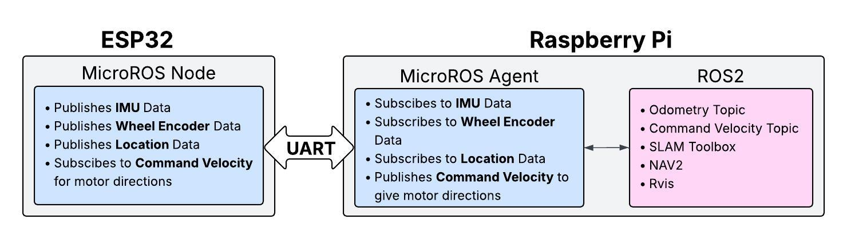
Software Design - MicroROS
Communication Framework

Slide 36
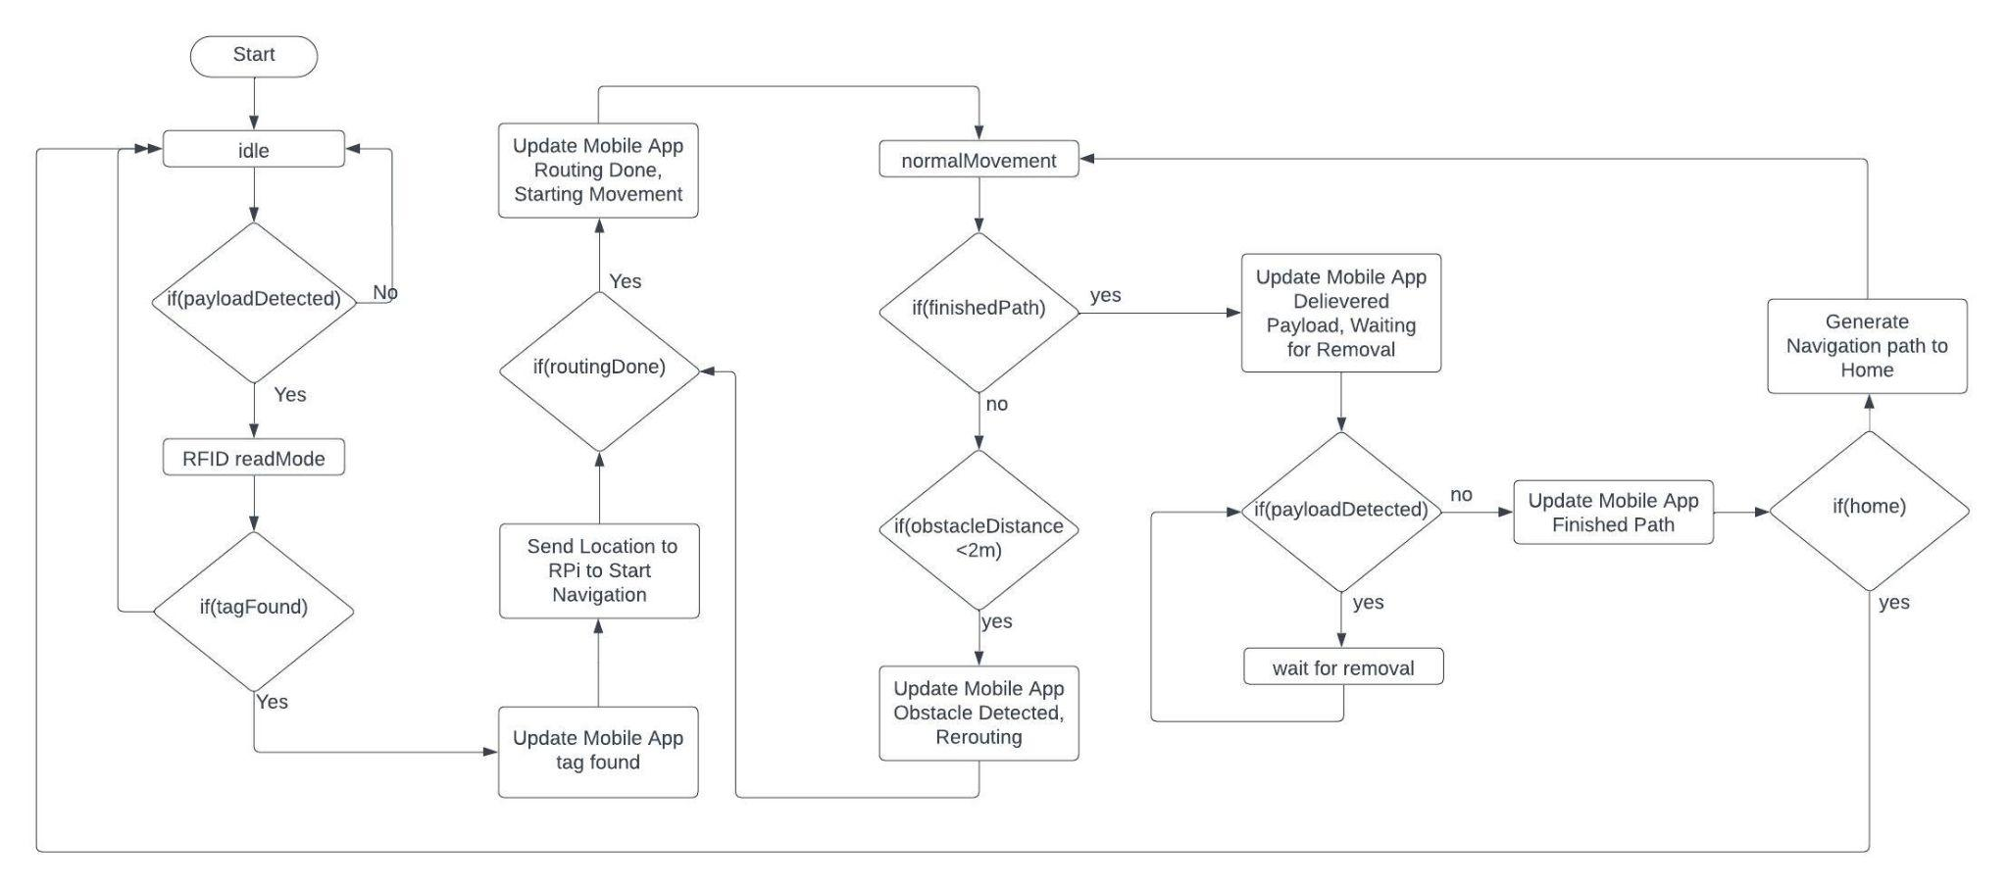
Software Design - State Diagram

Slide 37
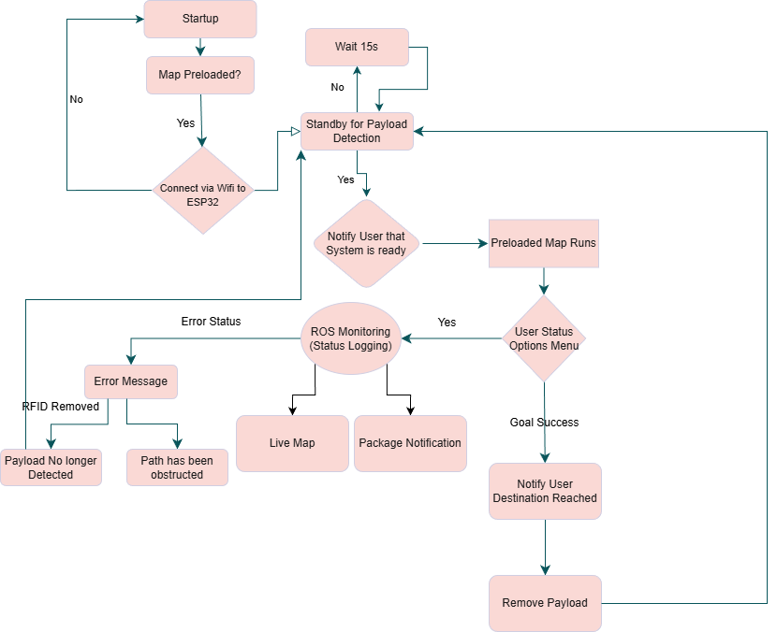
Software Design - Activity Flow Diagram

Slide 38
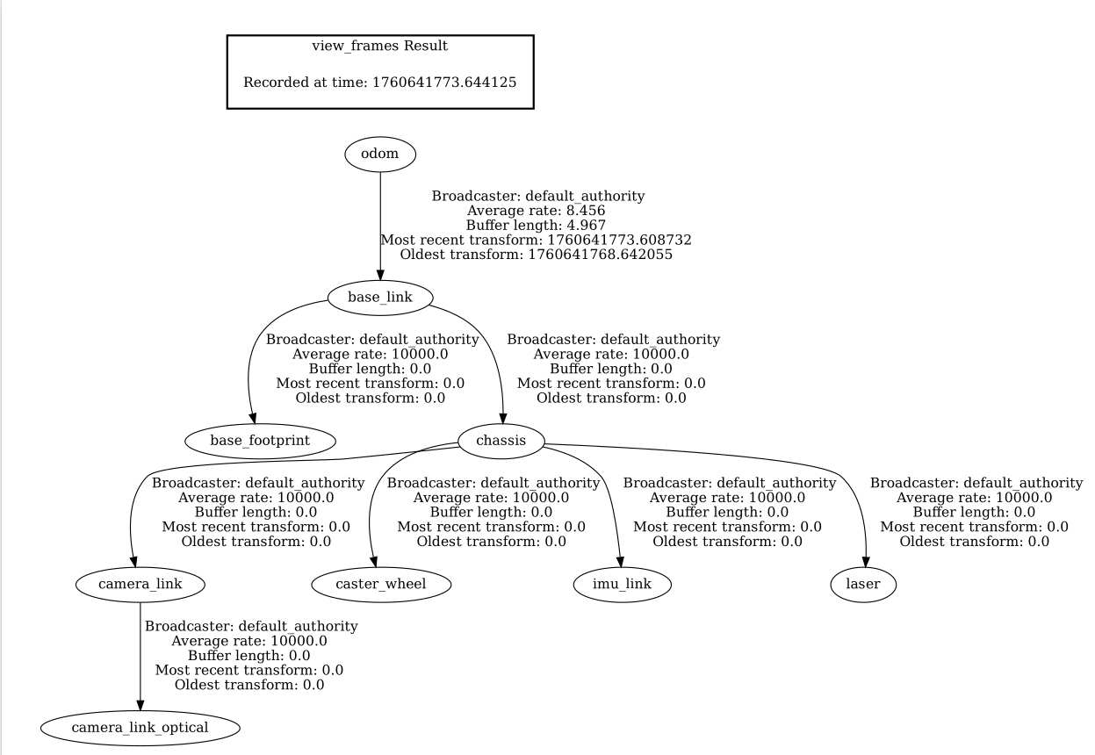
Software Design - SLAM Transform Tree

Slide 39
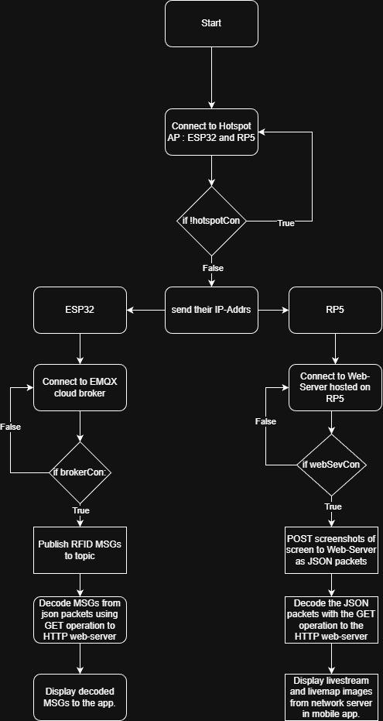
Software Design - Network Flow Diagram
Notes:
Network topology diagram (Network <-> App interaction)
The main focus is ensuring the network can connect properly before a session beings.
We ensure the ESP32 hosts a AP web-server and connects to the EMQX broker (MQTT cloud client) to publish messages to the web-server.
One thing I will like to note is we continuously attempt a connection to this web-server via it’s IP-address from the ESP32 (different from the phones standard IP-addr) in order to submit a GET request to the server, and obtain the telemetry data (RFID packets published from the broker) from the server.
Once the connection is established we move onto decoding the data (JSON packets) from the app and display the contents on the screen.
Next we ensure that the livemap and livestream services are running. This is done by accessing the Raspberry Pi’s IP-Addr from our mobile hotspot, and then repeating the same procedures as before with the ESP32. The main difference being we used Python versus C++ to instigate the backend API to save the data to our server on the backend, and decode it to be displayed in the frontend, resulting in us being able to decode individual frames to display the livestream and livemap to our app.
The connection process to establish a reliable connection to our web-server is similar to the ESP32 server. We continuously attempt to connect to the session, and once connected then move onto decoding & displaying the frames of our livestream/livemap on the app.
This process repeats until PARCLE reaches it’s final destination and the session is no longer operating.

Slide 40
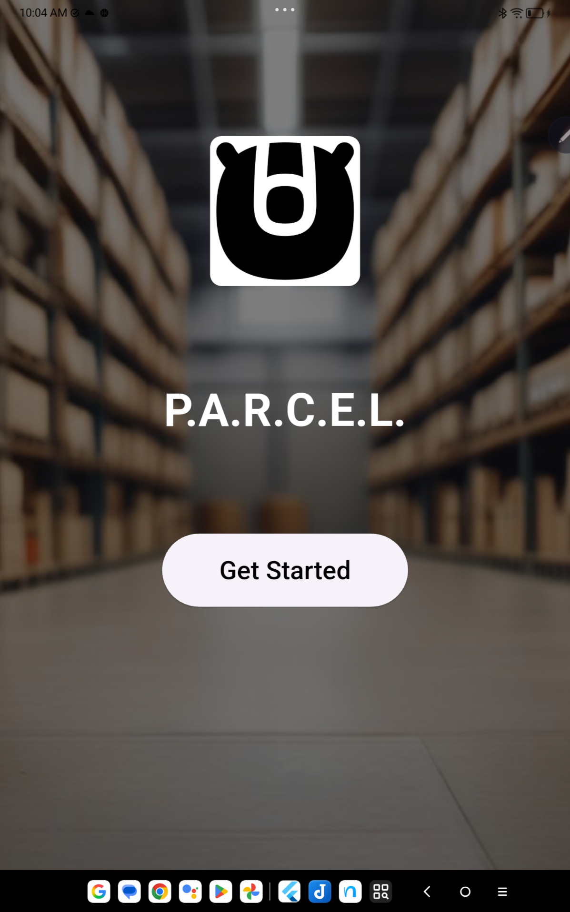
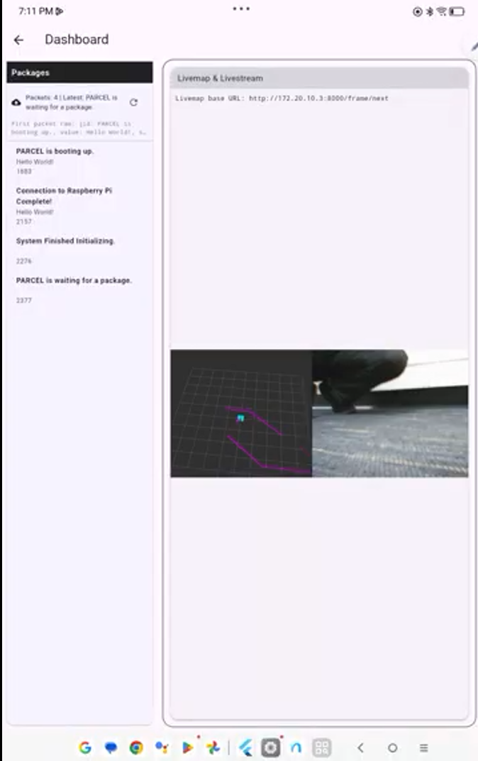
Software Design - Major App Functions
Major App Functions
Livestream of Camera
Displays Packages
Live Map Updates
Notes:
Livestream of Camera, Display package, and Live map update
As seen here we have an image of the livemap, livestream, and RFID messages displayed on the app.
The previous slides went more in depth how this process worked, so I will briefly summarize it here.
Each operation seen happens simultaneously on their own.
Each operation does not require a previous operation to finish before it begins another (it is not executing sequentially)
The information displayed relies on a reliable connection to the IP-address via our mobile hotspot to act as a AP to the network, enabling us to host web-servers to make this process possible.
Areas of improvement are the following
Smoother frame transitions of each image to give the users a better overall experience.
Prototyping code more using MOCKs to instigate expected behavior while finishing other features to improve overall development cycles of the Network & app portion.

Slide 41
Testing - Voltage Regulator Performance
3.3V Board #1
3.3V Board #2
5V Raspberry Pi Board
Requested Current (A) | Output Current (A) | Output Voltage (V)
0.1 | 0.1 | 3.24
0.25 | 0.25 | 3.14
0.5 | 0.499 | 2.97
Requested Current (A) | Output Current (A) | Output Voltage (V)
0.1 | 0.1 | 3.24
0.25 | 0.25 | 3.16
0.5 | 0.499 | 3.03
Requested Current (A) | Output Current (A) | Output Voltage (V)
0.5 | 0.498 | 4.92
1 | 0.999 | 4.91
1.5 | 1.499 | 4.91
2 | 1.999 | 4.91
3 | 2.999 | 4.90

Slide 42
Challenges - Hardware
Raspberry Pi 5 (1st) UART communication with ESP32 lost
ESP32 functionality lost
Raspberry Pi 5 (2nd & 3rd) failing to turn on
ESP32 failing to initialize I2C devices (IMU)
RFID failing to initialize

Slide 43
Challenges - Odometry
Strategies Implemented
IMU
  Testing IMU Accuracy
  Calibrating the IMU with a more precise IMU library
  Using an IMU Filter Node
Wheel Encoders
  Testing Encoder Data Accuracy
  Implementing a PID Controller to reduce drift

Slide 44
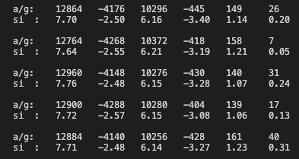
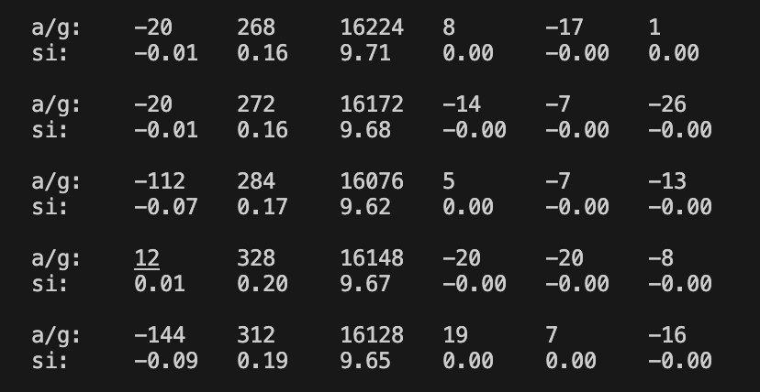
Testing - IMU Calibration
Before Calibration
After Calibration
Ax Ay Az Gx Gy Gz
Ax Ay Az Gx Gy Gz

Slide 45
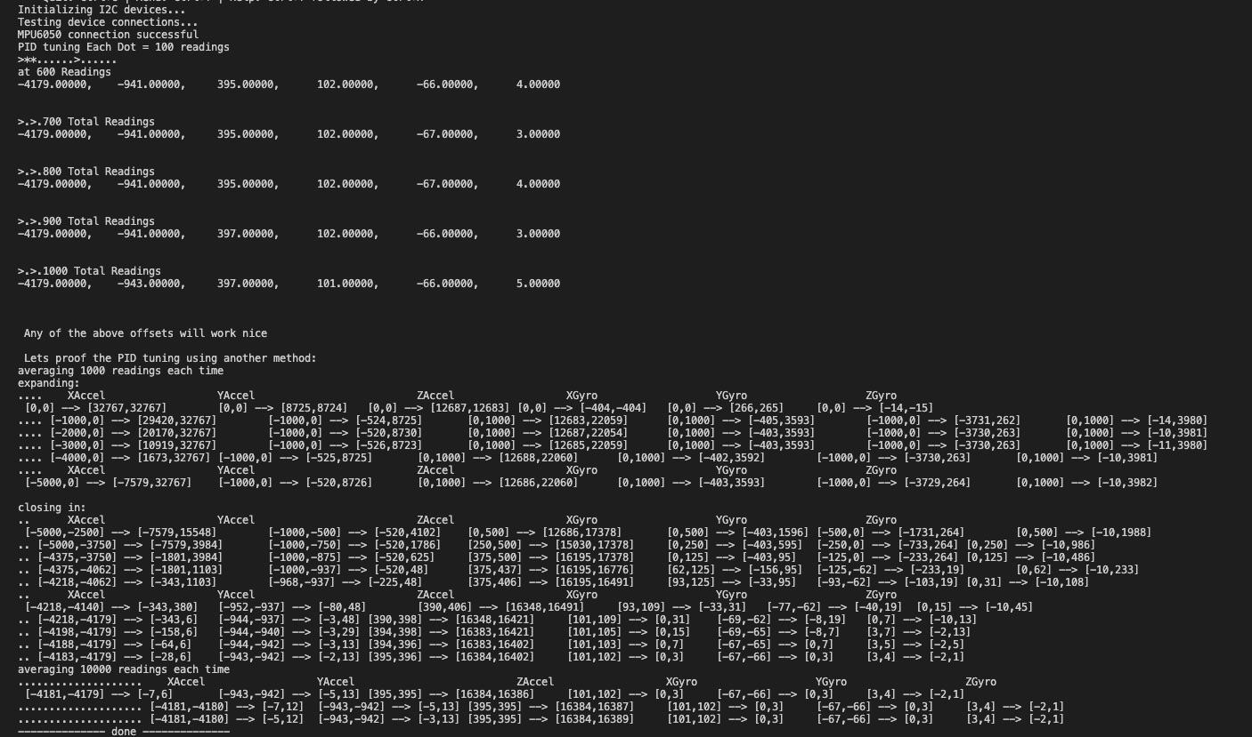
Testing - IMU Calibration
Calibrated on the robot with the lid closed on the main testing floor in atrium

Slide 46
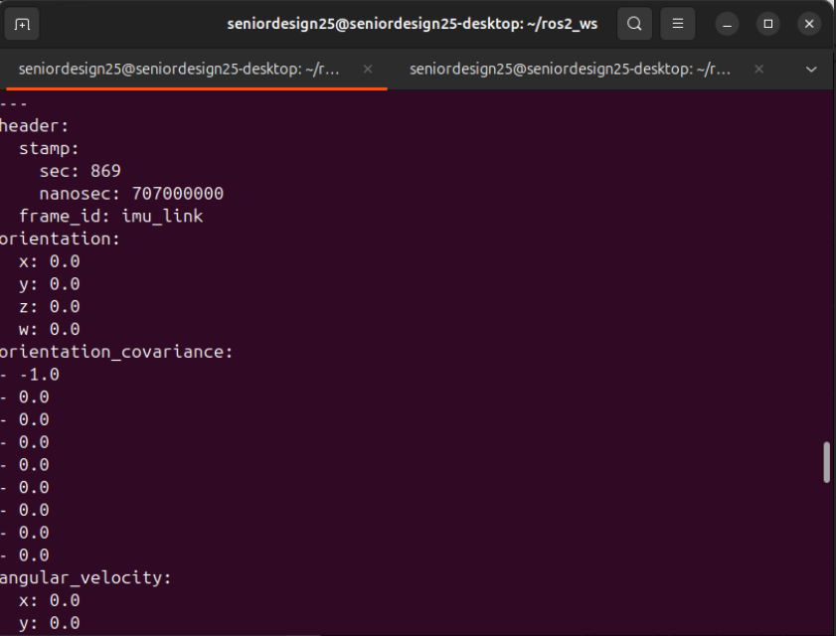
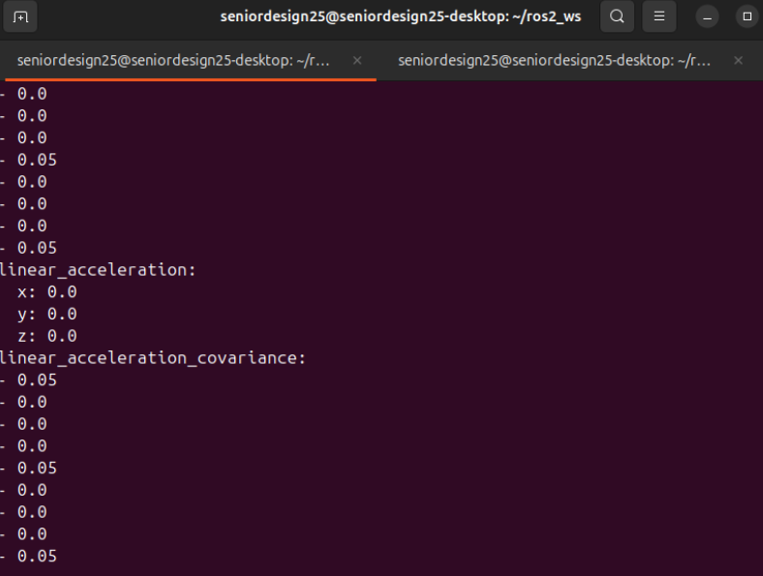
Testing - IMU Filter Node

Slide 47
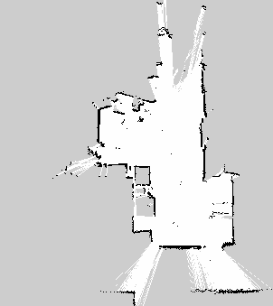
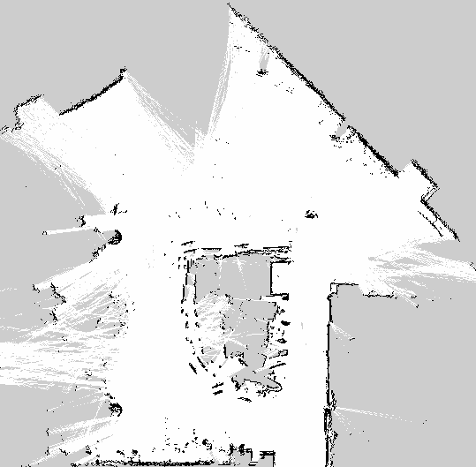
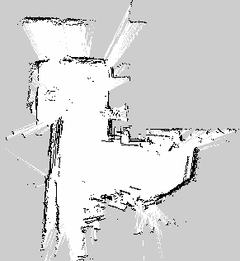
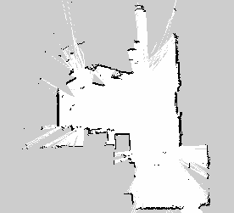
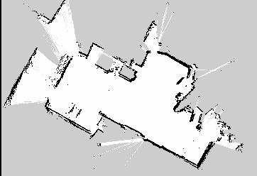
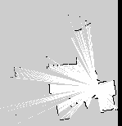
Testing - SLAM Map Generation
Before Untuned Wheel Odometry
After tuned Wheel Odometry

Slide 48
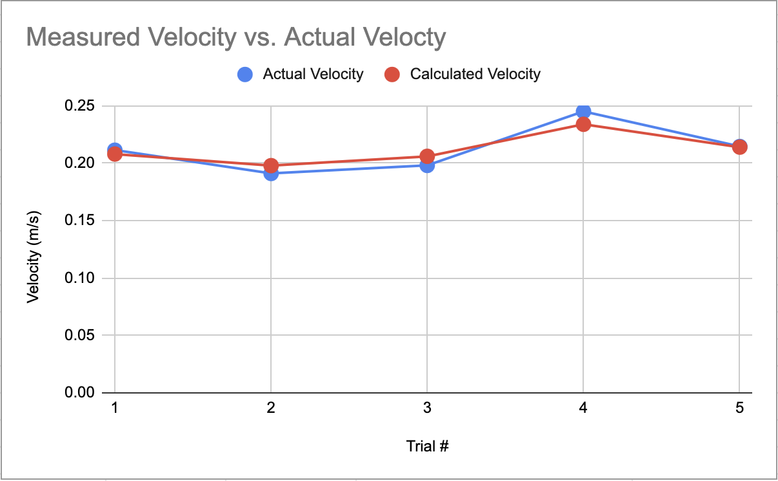
Testing - Motor Encoders
Before PID Controller with 75 PWM for 5 seconds with an Average error 0.22%
Measured from Right Wheel start to Right Wheel Stop and doesn’t account for the Left Wheel lagging considerable behind the right.

Slide 49
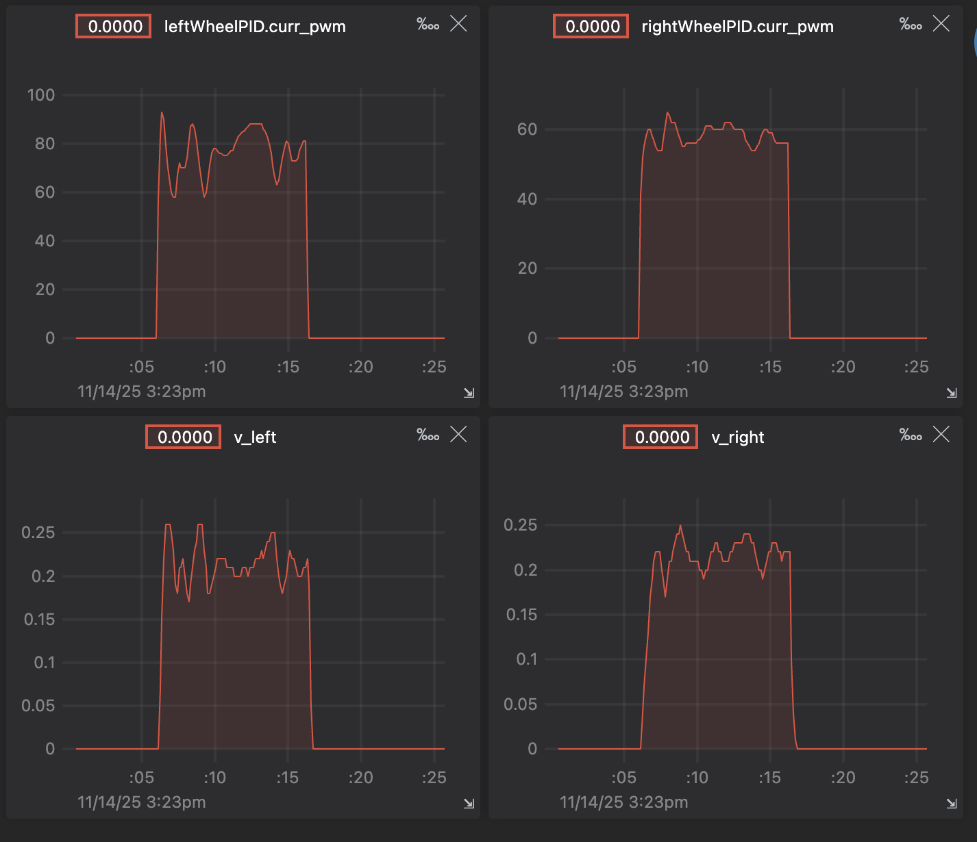
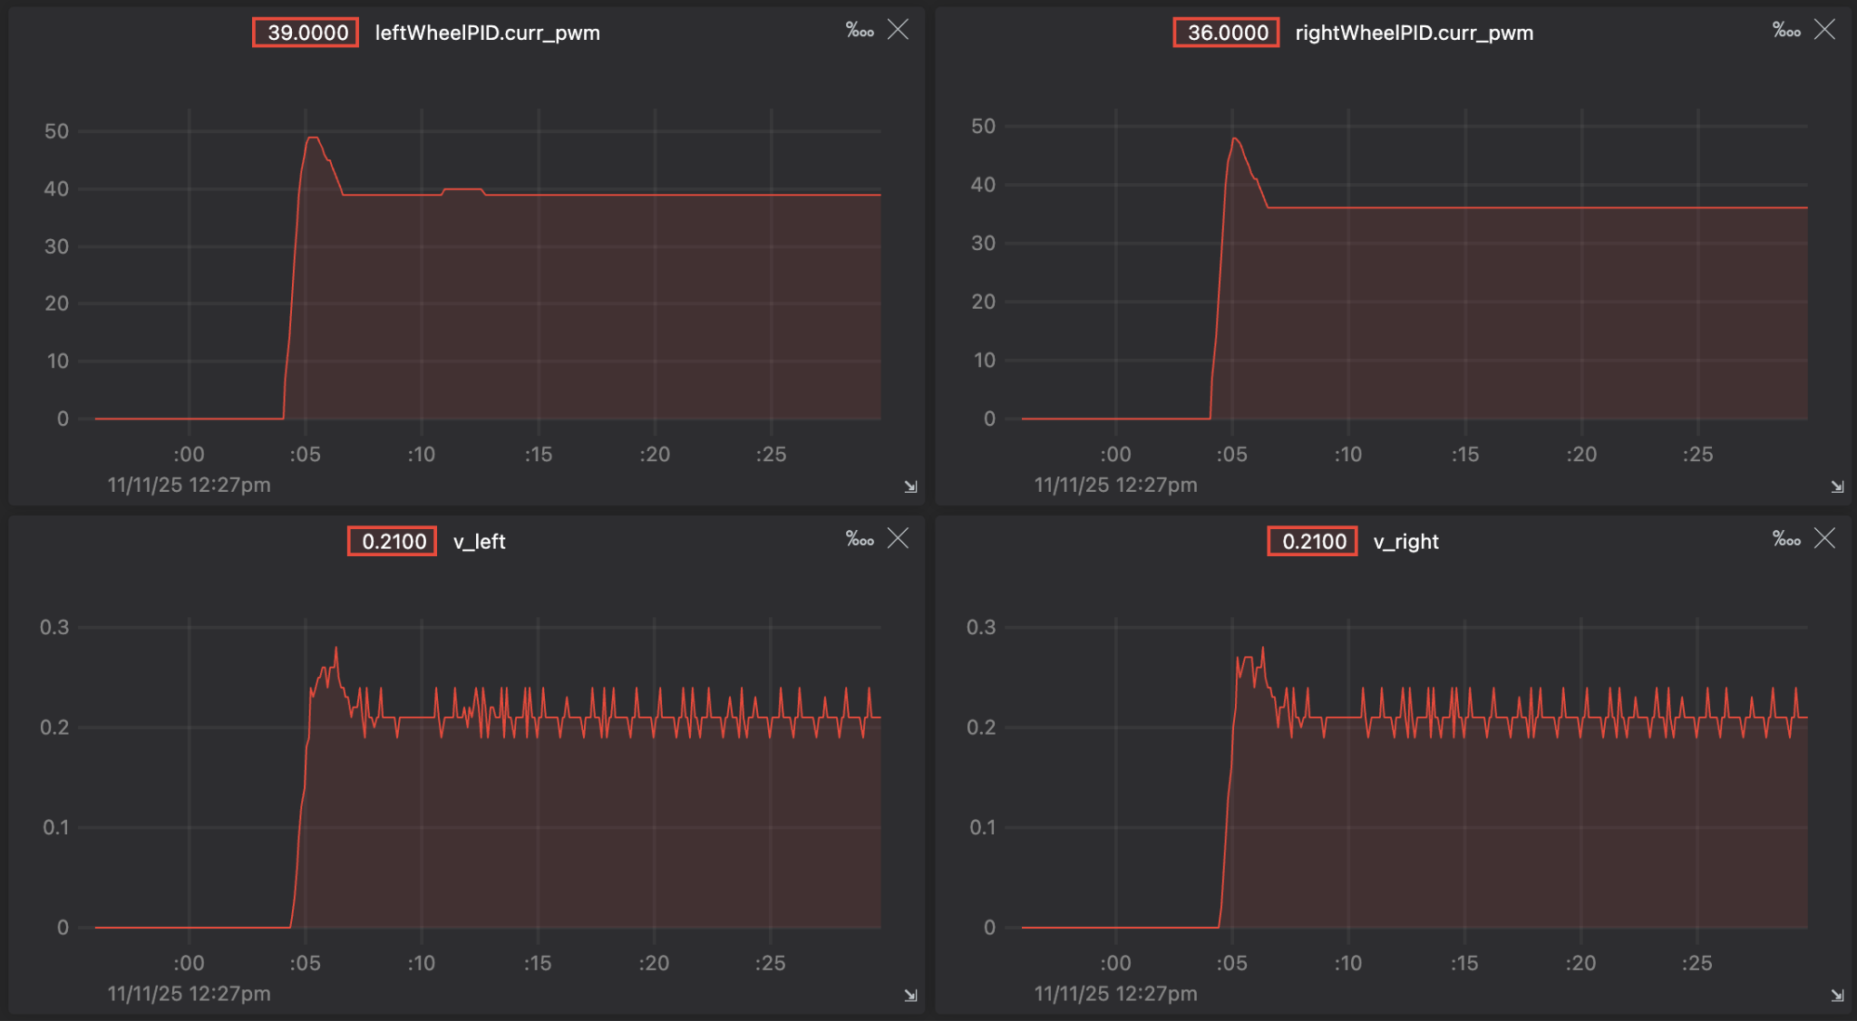
Testing - Motor Encoders
After PID Controller Tested set at a desired 0.22 m/s velocity
Final PID Gain Values
Left Wheel kp=0.35 ki=0 kd=0.05
Right Wheel k=0.15 ki=0 kd=0.05
Under Load
Not Under Load

Slide 50
Challenges - Navigation
Proposed Solution
Localization
  Ensure that AMCL (Adaptive Monte Carlo Localization) is active.
  Align LiDAR scans with pre-loaded map
Sensor Fusion
  Testing IMU filter Accuracy
  Testing Encoder Data Accuracy
Parameters:
  Adjust the parameters so the goal tolerance is with a meter and adjust the controller frequency to minimize computational load.

Slide 51
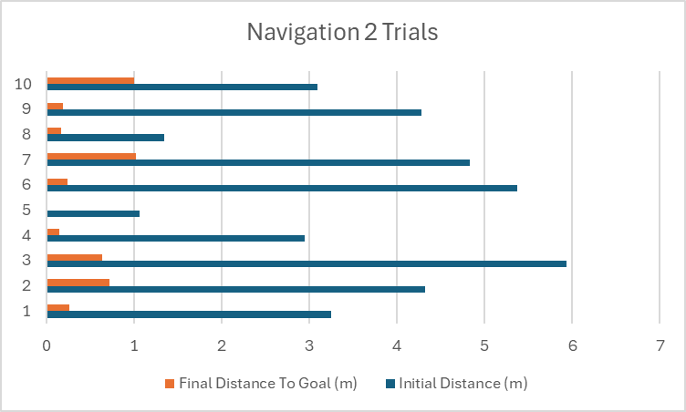
Testing - Navigation 2 Trials
Trials | Initial Distance (m) | Final Distance To Goal (m)
1 | 3.248 | 0.26
2 | 4.323 | 0.72
3 | 5.93 | 0.64
4 | 2.948 | 0.15
5 | 1.065 | 0.00
6 | 5.376 | 0.24
7 | 4.83 | 1.02
8 | 1.341 | 0.14
9 | 4.284 | 0.19
10 | 3.088 | 1.00

Slide 52
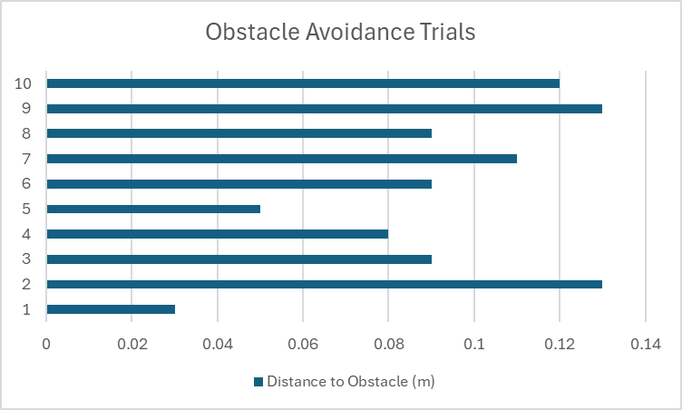
Testing - Obstacle Avoidance Trials
Trials | Distance to Obstacle (m)
1 | 0.03
2 | 0.13
3 | 0.09
4 | 0.08
5 | 0.05
6 | 0.09
7 | 0.11
8 | 0.09
9 | 0.13
10 | 0.12

Slide 53
Challenges - handling packets over network
Proposed Solution
ESP32 AP + Telemetry Web Server
  Configured the ESP32 as a WiFi AP hosting a mini HTTP server
  Bridged MQTT data by publishing packets to be exposed in the web-server.
  Mocked telemetry packets over the network to test how the backend and frontend handle incoming data.
  Sent frequent POSTs to the server, and GETs to the app to correctly display the RFID messages.
Raspberry Pi 5 Web Server (Livemap & Livestream)
  Configured HTTP server on the RP5 to send image frames over the network. These images were decoded to allow the viewer to see the information live.
Notes:
Basically read exactly what I wrote for challenges. It has everything I would generally say/explain that happened for the challenges section.

Slide 54
Administrative Content - Budget
System | Description | Estimated Cost
Power System | VR PCBs and batteries | $200
Electrical Hardware System | PCBs, sensors, components, and motors | $500
Mechanical Hardware System | Chassis, screws, mounts, and wheels | $75
Total |  | $775

Slide 55
Administrative Content - Work Distribution
Electrical Engineering | Responsibilities
Ibrahim Khater | PCB Design and Integration
 | Power management and distribution
 | PCB assembly
 | Chassis and mechanical design
Computer Engineering | Responsibilities
Riley Newport | MCU Software Development
 | MCU/Sensor Interfacing
 | MCU/Raspberry Pi Communication
 | Motor Control
Computer Engineering | Responsibilities
Melyia Ince-Ingram | Robot Operating System Set up
 | SLAM - Sensor Configuration
 | Camera Calibration
 | Robot Simulation
Computer Engineering | Responsibilities
Brandon Zabawa | Mobile App Dev.
 | Network Programming
 | Communication between MCU & App
 | SW verification

